Slide 1
Opportunities To Change The Outcomes Of Traumatized Children 2015
The Childhood Adversity Narratives
CAN
V2
CANarratives.org

Slide 2
CAN Contributors
Frank Putnam, MD, UNC at Chapel Hill, NC
William Harris, PhD, Children’s Research and Education Institute
& New School for Social Research, NYC, NY
Alicia Lieberman, PhD, UCSF, San Francisco, CA
Karen Putnam, PhD, UNC at Chapel Hill, NC
Lisa Amaya-Jackson, MD, Duke University, Durham, NC
CANarratives.org

Slide 3
Childhood Adversity Narratives
This is a Narrative that we are seeking to collectively construct with others.
The purpose is to help inform policy makers and the public about the costs and consequences of child maltreatment and adversity.
The goal is to show that there are proven interventions and opportunities to change these personally tragic and socially costly outcomes.
Feel free to use all or part of this Narrative (with appropriate attribution) if helpful to advocate for children and families.
CANarratives.org

Slide 4

Even the Experts are Confused as to Which Term is Best
Post Traumatic Stress Disorder?
Toxic Stress?
Chronic Stress?
ACES?
Complex Trauma?
Child Traumatic Stress?
Allostatic Load?
Complex PTSD?
Developmental Trauma Disorder?
Acute vs. Chronic Trauma?
CANarratives.org

Slide 5
There is No Single “Best” Term
Child trauma and adversity come in many forms and no term covers all of them.
In this Narrative we use ACES (Adverse Childhood Experiences) because it is one of the better known terms among the many audiences this Narrative seeks to reach.
The basic findings of the original ACES research¹ have been independently replicated by many different studies.
¹http://www.cdc.gov/violenceprevention/acestudy/prevalence.html
CANarratives.org

Slide 6
ACES (Adverse Childhood Experiences)¹
In this Narrative, ACES is used generically to refer to overlapping sets of traumatic and adverse childhood experiences and home environment factors that substantially increase a child’s risk for serious, lifelong medical and mental illnesses.
As the number of ACES increases, the negative outcome of interest (e.g., mental, medical, social, fiscal) increases in a graded (roughly stepwise) fashion.
This cumulative “ACES-effect” occurs at multiple levels from biological markers of stress within a person to population-based markers of health such as rates of childhood asthma in a neighborhood.
¹http://www.cdc.gov/violenceprevention/acestudy/prevalence.html
CANarratives.org

Slide 7
ACES Prevalence (%) of Abuse and Neglect In the Original Study¹
¹http://www.cdc.gov/violenceprevention/acestudy/prevalence.html
CANarratives.org

Slide 8
ACES Prevalence (%) of Household Dysfunction In the Original Study¹
¹http://www.cdc.gov/violenceprevention/acestudy/prevalence.html
CANarratives.org

Slide 9
Percent of Cumulative Adverse Childhood Experiences ACES in the Original Study¹
¹http://www.cdc.gov/violenceprevention/acestudy/prevalence.html
CANarratives.org

Slide 10
The ACES are Among Many
Childhood Traumas and Adversities Measured by the
National Child Traumatic Stress Network N=10,991¹
The original ACES (in red) are among the most commonly reported traumas in studies that look at additional traumas.
Over 40% of the children and adolescents served by the NCTSN experienced 4 or more different types of trauma and adversity.
Percent % Reported
¹Pynoos et. al (2014). Psychological Trauma: Theory, Research, Practice and Policy. 6:S9-S13.
CANarratives.org

Slide 11
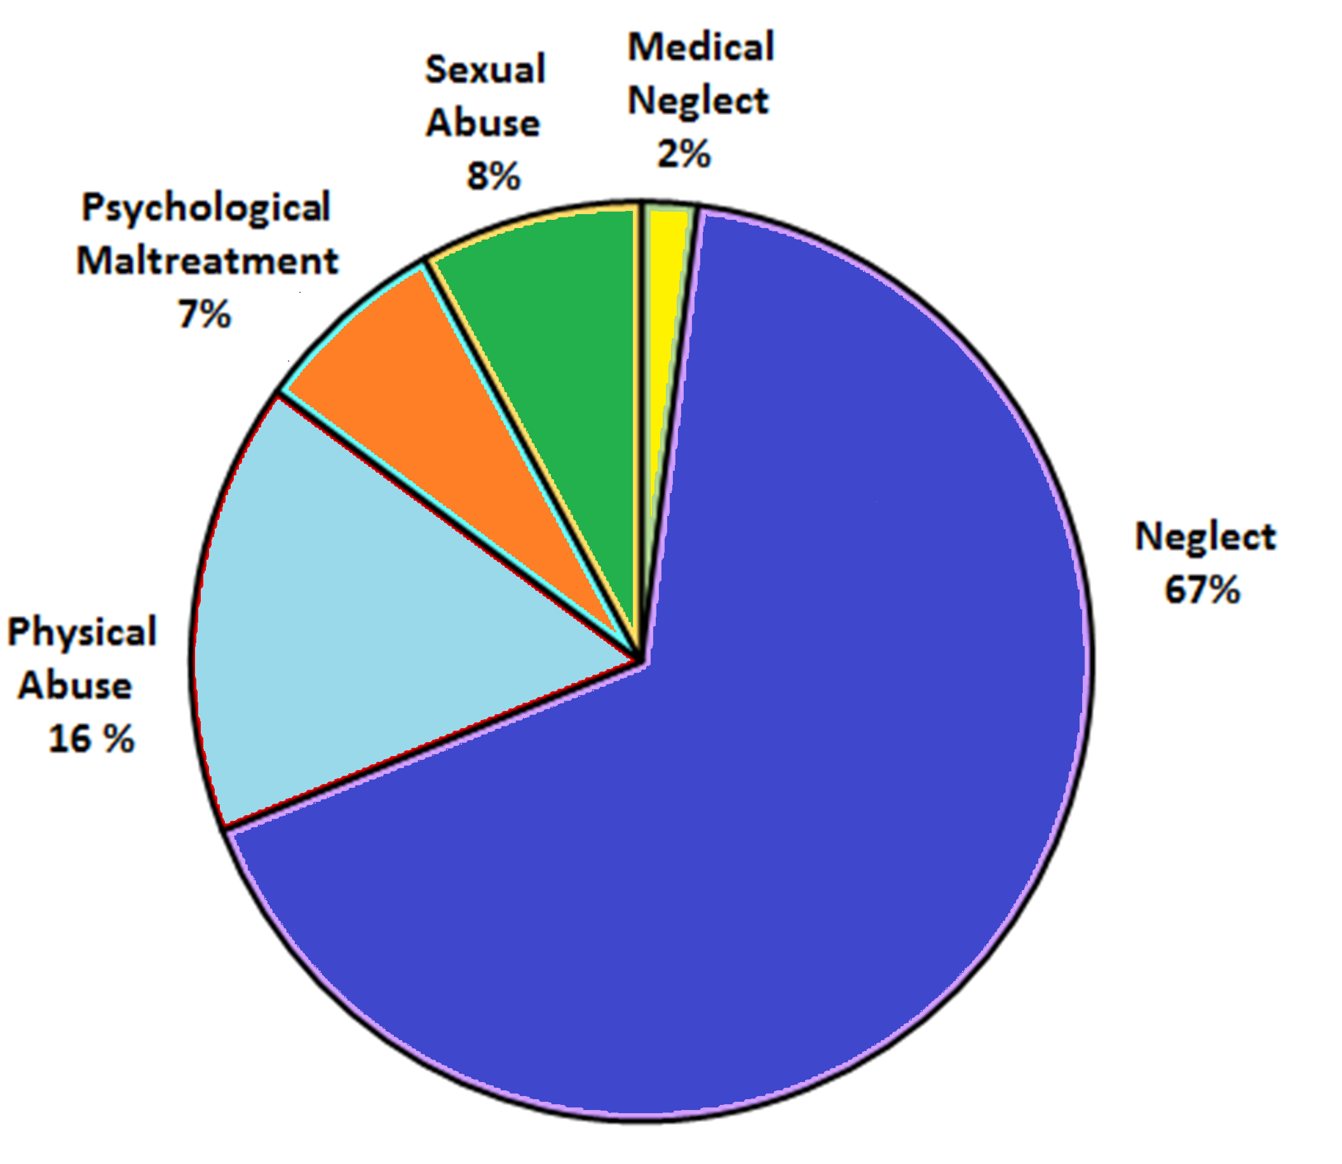
Rates of Maltreatment by Age¹
Most maltreatment happens to younger children.
Maltreatment has greater negative effects at younger ages.
Types of Child Maltreatment
Psychological
Maltreatment
7%
¹Child Maltreatment 2012. Washington, DC: US Department of Health and Human Services; 2014.
CANarratives.org

Slide 12
How the ACES Work
Adverse Childhood Experiences
Abuse and Neglect (e.g., psychological, physical, sexual)
Household Dysfunction (e.g., domestic violence, substance abuse, mental illness)
Impact on Child Development
Neurobiologic Effects (e.g., brain abnormalities, stress hormone dysregulation)
Psychosocial Effects (e.g., poor attachment, poor socialization, poor self-efficacy)
Health Risk Behaviors (e.g., smoking, obesity, substance abuse, promiscuity)
Long-Term Consequences
Disease and Disability
Major Depression, Suicide, PTSD
Drug and Alcohol Abuse
Heart Disease
Cancer
Chronic Lung Disease
Sexually Transmitted Diseases
Intergenerational transmission of abuse
Social Problems
Homelessness
Prostitution
Criminal Behavior
Unemployment
Parenting problems
High utilization of health and social services
Shortened Lifespan
CANarratives.org

Slide 13
How ACES Cross Generations
Generation 1
Child
Adolescent
Adult
Generation 2
CANarratives.org

Slide 14
Cumulative ACES Increase Risk for Poor Outcomes

Slide 15
Cumulative ACES & Mental Health^{1,2}
Prevalence %
¹Data from the National Comorbidity Survey-Replication Sample (NCS-R).
²Putnam, Harris, Putnam, J Traumatic Stress, 26:435-442, 2013.
CANarratives.org

Slide 16
Cumulative ACES & Chronic Disease¹
Prevalence %
¹Felitti et al., (1998) American Journal of Preventive Medicine, 14:245-258.
CANarratives.org

Slide 17
Cumulative ACES &
Impaired Worker Performance¹
Percent % Reported
¹Anda et al., (2004) The Permanente Journal/Winter 8:30-38.
CANarratives.org

Slide 18
Impact of Cumulative ACES & Social Dysfunction¹
Lower educational, occupational attainment.
Increased social service costs.
Increased medical costs.
Shortened life span.
Increased risk for HIV, teen pregnancy, maternal depression².
Intergenerational transmission of ACES to offspring.
¹IOM (Institute of Medicine) and NRC (National Research Council). 2013.
New Directions in child abuse and neglect research. Washington, DC: The National Academies Press.
²http://www.movingbeyonddepression.org/
CANarratives.org

Slide 19
Implications of Cumulative ACES
“Dose-Effect” – increasing ACES increases the number of problems.
Child maltreatment victims have 2-7 times higher risk of being re-victimized in the future compared with non-victims¹.
Preventing future ACES in previously traumatized children is an important intervention.
Systems that serve traumatized children – e.g., child protection, juvenile justice, mental health – should include trauma screening & prevention interventions.
¹Finkelhor et. al (2007). Re-victimization patterns in a national longitudinal sample of children and youth.
Child Abuse & Neglect 31:479-502.
CANarratives.org

Slide 20
Synergy
A principle finding of recent work is the extent to which two or more adverse experiences interact so that the risk of a psychological disturbance following is multiplied, often many times over.
John. Bowlby, The origins of attachment theory, 1988
CANarratives.org

Slide 21
Synergistic ACES Increase Complex Adult Psychopathology¹
People who experience one ACE are statistically likely to experience two or more ACES.
Synergy is the interaction of two or more ACES so that their combined effect is greater than the sum of their individual effects.
Complex Adult Psychopathology is defined as having diagnoses crossing 2 or more DSM diagnostic categories (Mood, Anxiety, Substance Abuse or Impulse Control).
¹Putnam, Harris, Putnam, J Traumatic Stress, 26:435-442, 2013.
CANarratives.org

Slide 22
Co-Existing Childhood Sexual Abuse & Household Domestic Violence ACES are Synergistic & Increase Risk of Complex Adult Psychopathology^{1,2}
Females (N=3310))
Increased Risk Due to ACE Synergy
Relative Risk & Additive Interaction
Childhood Sexual Abuse & Household Domestic Violence
¹Data from the National Comorbidity Survey-Replication Sample (NCS-R).
²Putnam, Harris, Putnam, J Traumatic Stress, 26:435-442, 2013.
CANarratives.org

Slide 23
Co-Existing Parental Substance Abuse & Parental Mental Illness ACES are Synergistic & Increase Risk of Complex Adult Psychopathology^{1,2}
Males (N=2382)
Increased Risk Due to ACE Synergy
Increased Risk Due to ACE Synergy
Relative Risk & Additive Interaction
Parental Substance Abuse & Parental Mental Illness
¹Data from the National Comorbidity Survey-Replication Sample (NCS-R).
²Putnam, Harris, Putnam, J Traumatic Stress, 26:435-442, 2013.
CANarratives.org

Slide 24
Synergistic ACES in Females ^{1,2}
In females synergy occurs with 2 or more ACES.
For females the most potent ACE, sexual abuse, is synergistic with:
Domestic violence
Crime victimization
Poverty
Parental mental illness (anxiety/depression)
Loss of a Parent
¹Data from the National Comorbidity Survey-Replication Sample (NCS-R).
²Putnam, Harris, Putnam, J Traumatic Stress, 26:435-442, 2013.
CANarratives.org

Slide 25
Synergistic ACES in Males ^{1,2}
In males synergy occurs with 3 or more ACES.
For males, the most potent ACE, poverty, is synergistic with:
Sexual abuse
Parental substance abuse
Loss of a parent
¹Data from the National Comorbidity Survey-Replication Sample (NCS-R).
²Putnam, Harris, Putnam, J Traumatic Stress, 26:435-442, 2013.
CANarratives.org

Slide 26
Synergy between ACES & Other Adversities (e.g., Environmental Pollution¹)
Childhood asthma disproportionally affects lower income communities where air pollution & ACES may be elevated.
Correcting for potential confounders – researchers found an increased risk between traffic-related air pollution and asthma (OR = 1.63, CI=1.14-2.33) solely among children exposed to violence.
ACES likely interact synergistically with many environmental pollutants and negative social experiences to increase risk for many costly illnesses.
¹Clougherty et al, (2007) Synergistic effects of traffic-related air pollution and exposure
To violence on urban asthma etiology. Environmental Health Perspectives 115:1140.
CANarratives.org

Slide 27
Addressing ACES Offers Critical Public Health Opportunities¹
ACES are the most preventable cause of serious mental illness.
ACES are the most preventable causes of drug and alcohol abuse in women.
ACES are the most preventable causes of HIV high-risk behavior (IV drugs, promiscuity).
ACES are a significant contributor to leading causes of death (heart disease, cancer, stroke, diabetes, suicide).
¹IOM (Institute of Medicine) and NRC (National Research Council). 2013.
New Directions in child abuse and neglect research. Washington, DC: The National Academies Press.
CANarratives.org

Slide 28
Costs of Cumulative & Synergistic ACES
Human suffering borne by victims & their families.
Economic costs borne by society.
Social costs borne by society.
Intergenerational transmission of childhood adversity borne by future society.
CANarratives.org

Slide 29
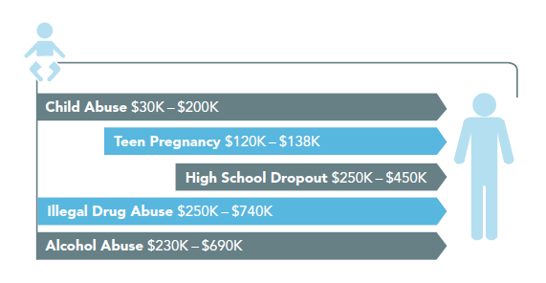
What does it cost to do nothing?
Each 2014 First-Time Case of Child Maltreatment Costs U.S. Economy
Approximately $1.8 Million in Total Expenditures over their Lifetime¹
$1.8 Million per 2014 victim¹
Graphic from Pew Issue Brief Jan 2011: Paying Later: High Cost of failing to Invest in Young children.
¹Suffer the Little Children: An Assessment of the Economic Costs of Child Maltreatment
The Perryman Group, Nov. 2014: http://perrymangroup.com/special-reports/chlld-abuse-study/
CANarratives.org

Slide 30
Estimated Lifetime Costs for all 2014 First Time Maltreatment Victims = $5.9 Trillion¹
$5.9 Trillion
¹Suffer the Little Children: An Assessment of the Economic Costs of Child Maltreatment
The Perryman Group, Nov. 2014: http://perrymangroup.com/special-reports/chlld-abuse-study/
CANarratives.org

Slide 31
Can We Do Anything?

Slide 32
What Do We Have Available Now?
Proven (evidence-based) prevention & treatment interventions.
Existing programs provide opportunities within which to embed screening, prevention & treatments.
Replication strategies (e.g., National Child Traumatic Stress Network (NCTSN)¹ Learning Collaboratives) to expand access to services.
Web networking & data collection tools to support large scale interventions.
Prevention & quality improvement science to enhance interventions while they are being delivered.
¹www.nctsn.org
CANarratives.org

Slide 33
Child Abuse Prevention
Evidence-based prevention programs exist (e.g., high quality home visitation, Triple P - Promoting Positive Parenting).
CDC meta-analysis of home visitation - median 40% reduction with maximum 80% in official case reports.
Triple-P population-based clinical trial – population effect size d = 0.51 (reduces substantiated cases, out-of-home placements, maltreatment injuries).
Dissemination strategies for ‘going to scale’ with these models exist.
Economic analyses exist documenting cost-effectiveness of the best prevention programs.
CANarratives.org

Slide 34
Treatment
Proven treatments exist for traumatized children, e.g.,
- TF CBT -Trauma-Focused Cognitive Behavioral Therapy
- CPP - Child Parent Psychotherapy
- PCIT -Parent Child Interaction Therapy
Children with 4 or more ACEs respond as well to treatment as children with fewer adversities¹.
Therapists who follow guidelines carefully get the best results.
Treatments can improve both children and parents’ mental health outcomes.
Treatment appears to restore normal biology in stress response systems in some instances.
¹Ghosh Ippen C., et al.,(2011) Child Abuse & Neglect, doi:10.1016/j.chiabu.2011.03.009.
CANarratives.org

Slide 35
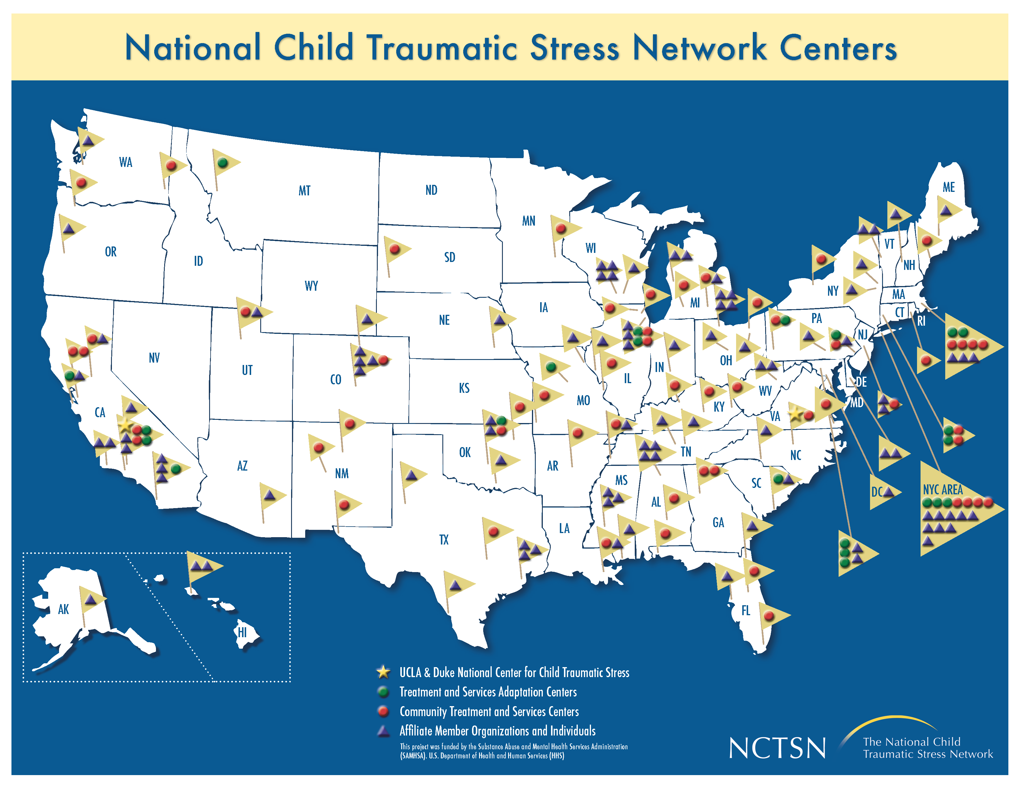
The National Child Traumatic Stress Network (NCTSN) Centers and Affiliated Agencies Provide Proven Treatments to Traumatized Youth Nationwide¹
NCTSN Centers and Affiliates as of 2013
¹www.nctsn.org
CANarratives.org

Slide 36
NCTSN Children & Adolescents
At Baseline and Last Follow up¹
Percentage %
¹The National Child Traumatic Stress Network CDS September 2010 – www.nctsn.org
CANarratives.org

Slide 37
Prevention & Treatment Costs
Are prevention & treatment programs cost-effective?
High quality home visiting child abuse prevention programs have been found to return ~ $3.00/dollar of cost¹.
Evidence-based child trauma treatments such as Parent-Child Interaction Therapy (PCIT) return $3.64/dollar cost¹.
¹Benefits and Costs of Early Intervention and Prevention Programs, Sept, 2004.
http://www.wsipp.wa.gov/rptfiles/04-07-3901a.pdf.
CANarratives.org

Slide 38
Preventing ACES is Protective Within & Across Generations
Having Zero (0) ACES significantly protects against child & adult mental illness^{1,2}.
Developmental models postulate that resilience decreases as ACES increase.
Positive childhood experiences³ (“Angels in the Nursery”⁴) can offset negative childhood experiences.
¹Putnam, Harris, Putnam, J Traumatic Stress, 26:435-442, 2013.
²Bethell, CD, et al, (2014). Health Affairs, 33:2106-2115.
³Chung et al, Ambulatory Pediatrics 2008; 8:109-116.
⁴Lieberman, et al, Infant Mental Health Journal 2005, 26(6) 504-520.
CANarratives.org

Slide 39
Measuring Risk
An Odds Ratio (OR) is a statistic quantifying the strength of association between two factors in a population, e.g., fatty diet and heart disease, smoking and lung cancer.
If the OR is greater or less than 1, then the two factors are significantly associated. If the OR equals 1 there is not a significant association.
ORs are often used to quantify how much a certain factor (e.g., a gene, diet, habit) increases or decreases a person’s risk for a negative outcome.
CANarratives.org

Slide 40
Public Health Thresholds of Risk for
Legislation, Regulation or Recommendations
¹Putnam et. al. JTS, 26:435-442,2013. ²Brennan et. al. Int J Cancer, 109:125-31,2004. ³Klauer et.al. NEJM, 370:54-59,2014.
⁴Froehlich et. al. Pediatrics, 124:1054-1063,2009. ⁵Lazovich et, al. Cancer Epidemiol Biomarker Prev., 19:1557-1568,2010.
CANarratives.org

Slide 41
CANarratives.org

Slide 42
e.g., OR for second hand smoke and lung cancer
CANarratives.org

Slide 43
Prevention, Screening, & Treatment Can Be Embedded In Existing Systems That Serve Children
Child care
Education
Medical
Well-child
Home visitation
Military families
Foster Care
Child welfare
Mental health
Drug and alcohol
Juvenile justice
Immigration
Faith based
CANarratives.org

Slide 44
Summary
ACES are cumulative & synergistic.
Females and males have different (but overlapping) combinations of synergistic ACES.
ACES increase risk for major public health problems far in excess of the usual thresholds (i.e., ORs ≥ 1.4 – 1.8) for interventions.
ACEs may be synergistic with environmental exposures or social experiences, e.g., air pollution & childhood asthma.
CANarratives.org

Slide 45
What More Can We Do?
Adopt a Public Health approach to Child Maltreatment and other ACEs by:
Screening for ACEs in systems that serve children and families.
Building capacity to prevent & treat child trauma.
Increasing access to trauma-informed services for children & families.
Integrating and enhancing programs to target synergistic ACEs with highest cumulative risks.
Integrating trauma services across family-serving systems.
CANarratives.org

Slide 46
How Would We Do It?
Disseminate proven interventions (e.g., NCTSN learning collaboratives).
Incentive-based credentialing and/or rostering of trained clinicians.
Continuous monitoring of intervention outcomes.
Internet systems to manage large scale programs:
Clinical data collection for referrals, outcome analyses & clinician feedback
Interactive training and education
Program management
Networking among providers and stakeholders
Continuous Quality Improvement (CQI) – to improve working programs while delivering services in the field.
CANarratives.org

Slide 47
What Are The Expected Outcomes?
Reduced Human Suffering.
Decreased costly Mental & Medical Illness.
Reduction in Health Risk Behaviors (e.g., smoking, substance abuse, poor diet).
Improved Population Health & Well-Being.
Decreased Intergenerational Transmission of ACES.
Improved Educational & Occupation Attainment.
Decreased Crime & Victimization.
Decreased Welfare & Social Services.
Increased Productivity & Life Expectancy.
CANarratives.org

Slide 48
How Can a Public Effort Help Us?

Slide 49
Christof Wieland, the German man of letters, wrote in 1798 that public opinion was “ . . . an opinion that gradually takes root among a whole people; especially among those who have the most influence when they work together as a group. In this way it wins the upper hand to such an extent than one meets it everywhere… It then only requires some small opening that will allow it air, and it will break out with force. Then it can change whole nations in a brief time and give whole parts of the world a new configuration.” ¹
Christof Wieland, 1798
¹Daniel J. Boorstin, Democracy and Its Discontents Reflections on Everyday America, Vintage Books p14, 1975.
CANarratives.org

Slide 50
Resource URLs
ACES
TED Talk - www.ted.com/talks/nadine_burke_harris_how_childhood_trauma_affects_health_across_a_lifetime
CDC - www.cdc.gov/violenceprevention/acestudy/index.html
Evidence Based Treatment & Prevention
NCTSN www.nctsn.org
Children’s Bureau http://www.acf.hhs.gov/programs/cb
SAMHSA http://www.samhsa.gov/ebp-web-guide
Maternal Depression http://www.movingbeyonddepression.org/
Advocacy & Policy
AAP www.aap.org/en-us/Pages/Default.aspx
APAs www.apa.org & www.psychiatry.org
AACAP www.aacap.org
Additional Resource URLs: CANarratives.org
CANarratives.org

